Slide 1
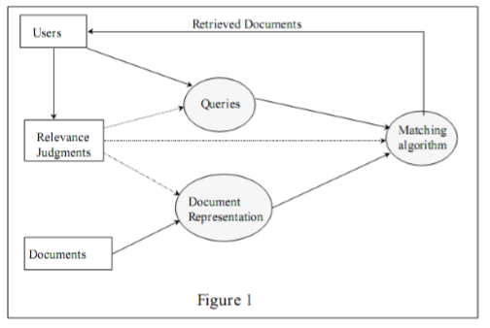
Information Retrieval Systems
A document based IR system typically consists of three main subsystems: document representation, representation of users' requirements (queries), and the algorithms used to match user requirements (queries) with document representations. The basic architecture is as shown in figure 1.

Slide 2
Information Retrieval Systems
A document collection consists of many documents containing information about various subjects or topics of interests. Document contents are transformed into a document representation (either manually or automatically). Document representations are done in a way such that matching these with queries is easy. Another consideration in document representation is that such a representation should correctly reflect the author's intention. The primary concern in representation is how to select proper index terms. Typically representation proceeds by extracting keywords that are considered as content identifiers and organizing them into a given format. Queries transform the user's information need into a form that correctly represents the user's underlying information requirement and is suitable for the matching process. Query formatting depends on the underlying model of retrieval used. The user rates documents presented as either relevant or non-relevant to his/her information need. The basic problem facing any IR system is how to retrieve only the relevant documents for the user’ s information requirements, while not retrieving non- relevant ones.

Slide 3
Areas of IR application
Information retrieval (IR) systems were originally developed to help manage the huge scientific literature that has developed since the 1940s. Many university, corporate, and public libraries now use IR systems to provide access to books, journals, and other documents. Commercial IR systems offer databases containing millions of documents in myriad subject areas. Dictionary and encyclopaedia databases are now widely available for PCs. IR has been found useful in such disparate areas as office automation and software engineering. Indeed, any discipline that relies on documents to do its work could potentially use and benefit from IR.

Slide 4
General applications of information retrieval:
Digital Library
A digital library is a library in which collections are stored in digital formats (as opposed to print, microform, or other media) and accessible by computers. The digital content may be stored locally, or accessed remotely via computer networks. A digital library is a type of information retrieval system.
Recommender systems
Recommender systems or recommendation engines form or work from a specific type of information filtering system technique that attempts to recommend information items (films, television, video on demand, music, books, news, images, web pages, etc) that are likely to be of interest to the user. Typically, a recommender system compares a user profile to some reference characteristics, and seeks to predict the 'rating' that a user would give to an item they had not yet considered.

Slide 5
General applications of information retrieval:
Search Engines
A search engine is one of the most the practical application of information retrieval techniques to large scale text collections. Web search engines are best known examples, but many others searches exist, like: Desktop search ,Enterprise search ,Federated search ,Mobile search ,Social search.
Media search
An image retrieval system is a computer system for browsing, searching and retrieving images from a large database of digital images. Most traditional and common methods of image retrieval utilize some method of adding metadata such as captioning, keywords, or descriptions to the images so that retrieval can be performed over the annotation words. Manual image annotation is time-consuming, laborious and expensive; to address this, there has been a large amount of research done on automatic image annotation. Additionally, the increase in social web applications and the semantic web have inspired the development of several web-based image annotation tools.

Slide 6
IR Algorithms
It is hard to classify IR algorithms, and to draw a line between each type of application. However, we can identify three main types of algorithms, which are described below. There are other algorithms used in IR that do not fall within our description, for example, user interface algorithms. The reason that they cannot be considered as IR algorithms is because they are inherent to any computer application.
We distinguish three main classes of algorithms. These are retrieval, indexing, and filtering algorithms.

